Slide 1

J.A.R.V.I.S
Team Name: Something
Céin O’Rourke, Jordan Forde
Daniel Tilly, Éanna Brennan
Andrew Leech

Slide 2
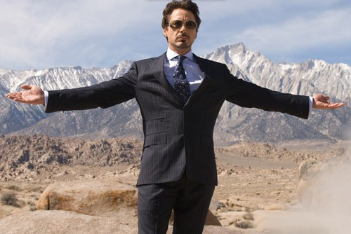
Tony Stark
Genius, Billionaire, Playboy, Philanthropist
MIT
Stark Industries
Kidnapped by Terrorists
Chest Piece

Slide 3
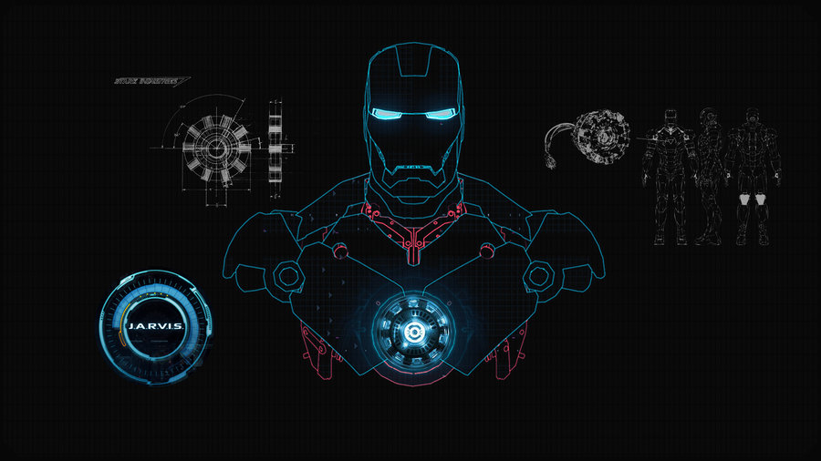
History of J.A.R.V.I.S
Just a Rather Very Intelligent System
Edwin Jarvis
Iron Man suit

Slide 4
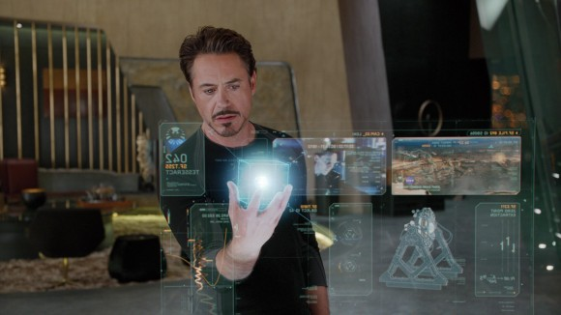
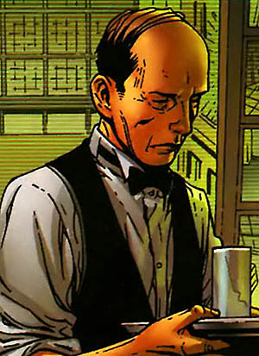
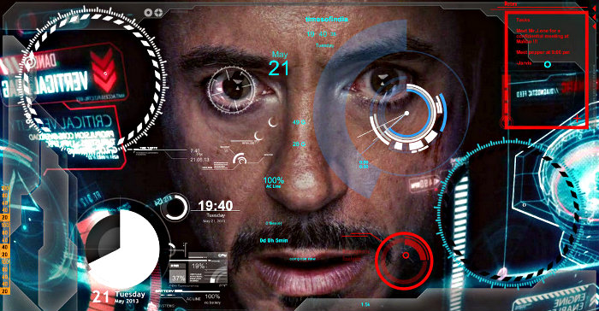
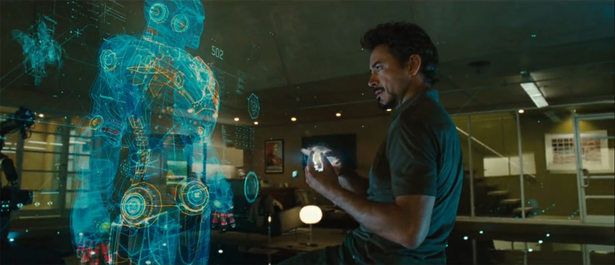
J.A.R.V.I.S at Work

